Slide 1
Prediction of Breast Cancer Diagnosis
Capstone Project
Advisors: Dr. Monica Poindexter and Dr. Babatunde Olubando

Slide 2





Meet the Team
Kayla Thames
Project Lead
Electrical and Computer Engineering
Javon Barrett
Researcher
Electrical Engineering
Chauncey Murray
Project Editor
Electrical Engineering
Aria Jones
Graphic Designer
Industrial Engineering
Xavier Hicks
Programmer
Electrical Engineering

Slide 3
Table of Contents
Introduction
Why did we choose this topic?
How does this topic affect the community?
Project Procedures
Lessons Learned
Future Research
References

Slide 4
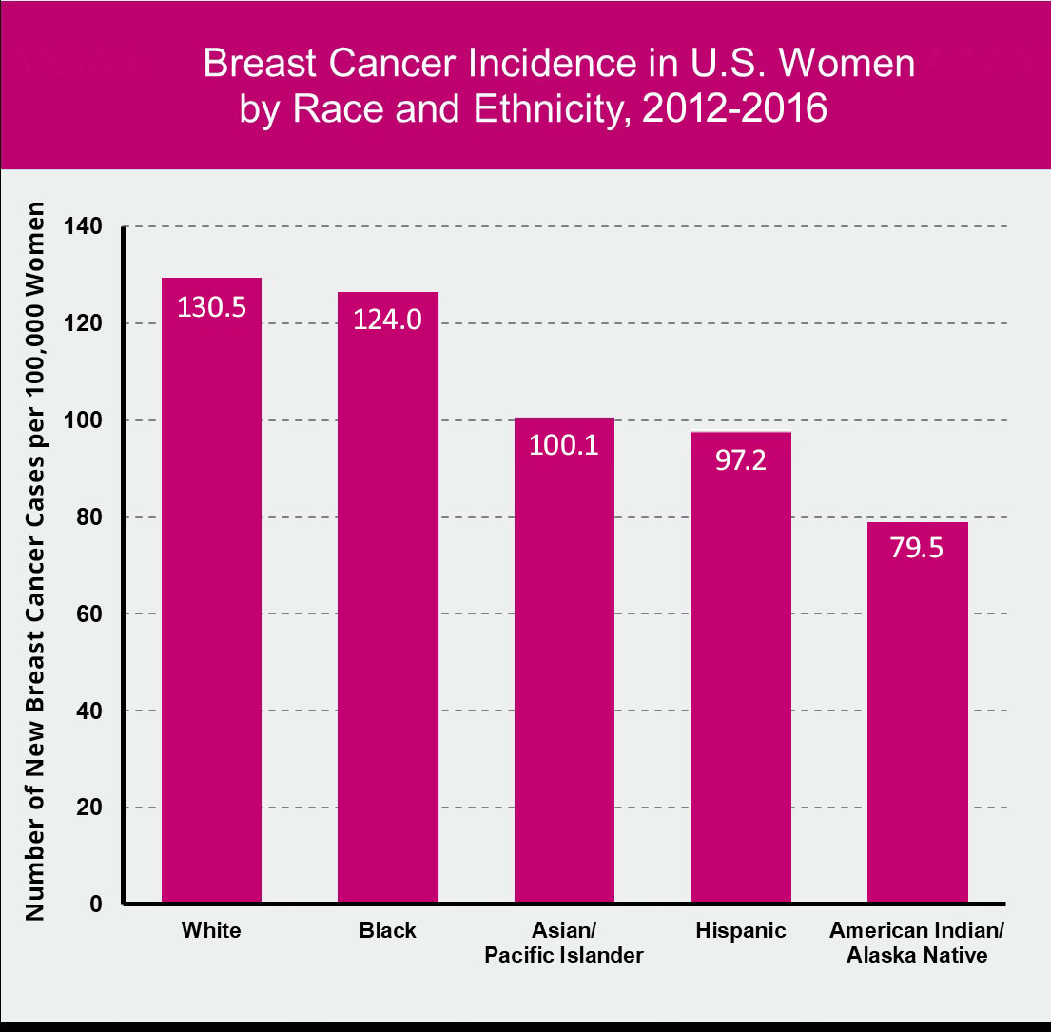
Introduction
Breast cancer is more common in women ¹
Not completely preventable but can lower risk with diet
Early detection = High survival rates ¹
Machine learning model predicts breast cancer.
The model uses information about benign & malignant tumors
Source: Susan G. Komen
Notes:
13% or ⅛ chance women develop breast cancer in their life.
Preventing breast cancer by eating fruits and veggies
Survival rate in early stage 0 99% 5 years after diagnosis
Survival rate in stage 4 is 28%
mortality was 41% higher among black women (29.2 deaths per 100,000 population) than white women (20.6 deaths per 100,000 population)
Radius and smoothness

Slide 5
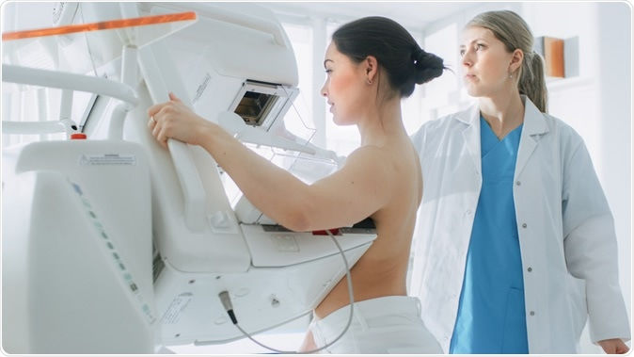
Why did we choose this topic?
1 out of 8 chance of diagnosis ¹
3.8 million currently diagnosed ¹
Everyone is at risk
Nearly 44,000 deaths in 2021 ²
Prioritize early detection & treatment

Slide 6

How does this topic affect the community?
Early detection increases the rate of survival(most treatable)
Spread awareness
Cancer diagnosis affects personal relationships(sadness, anxiety, etc…)
Many people endure emotional and mental hardships while they are undergoing treatment

Slide 7

Project Procedures
Acquired dataset from kaggle
Load and Read Dataset
Perform an Exploratory Data Analysis
Clean the Dataset
Select Experimental Models
Test Models
Compare the two models

Slide 8
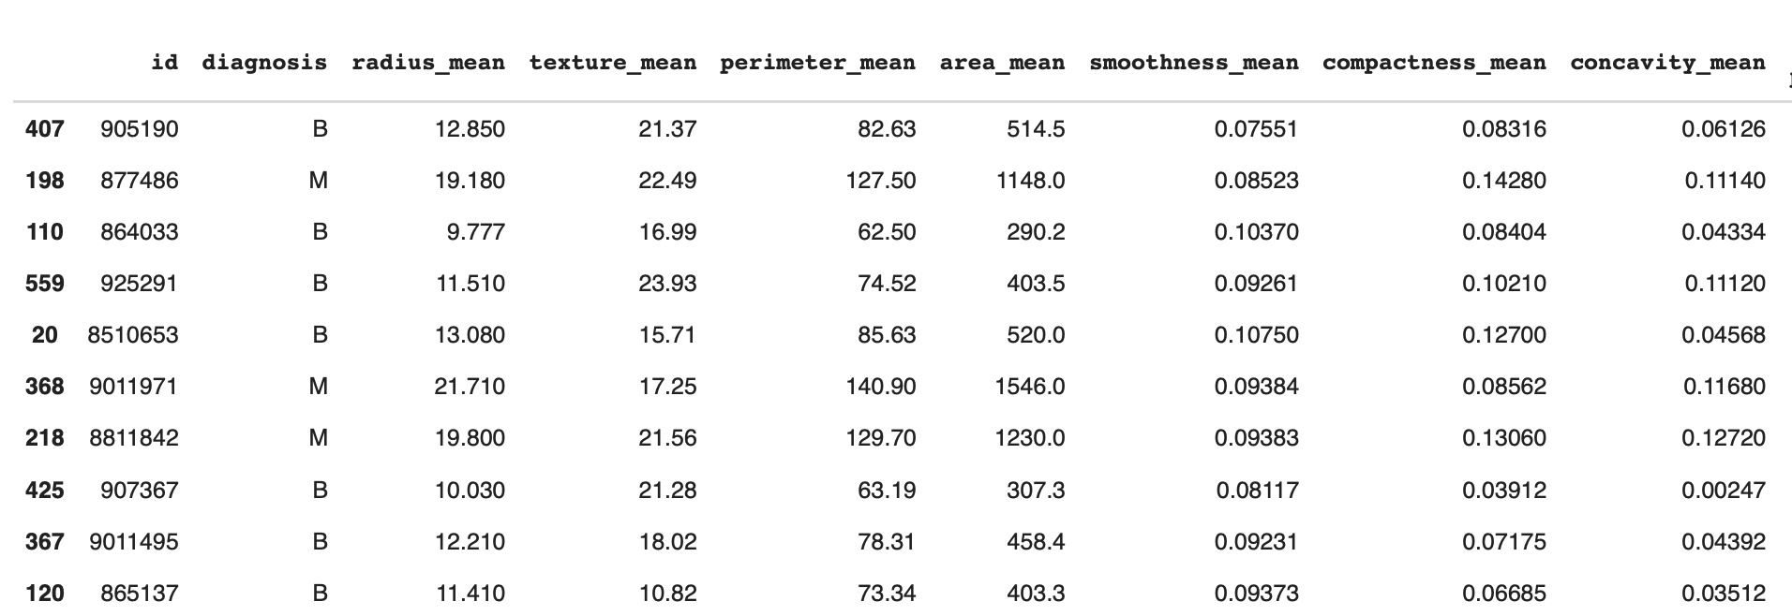
Load and Read Data
Test and analyze

Slide 9
Exploratory Data Analysis
Box Plots
Heatmaps
Scatterplot

Slide 10
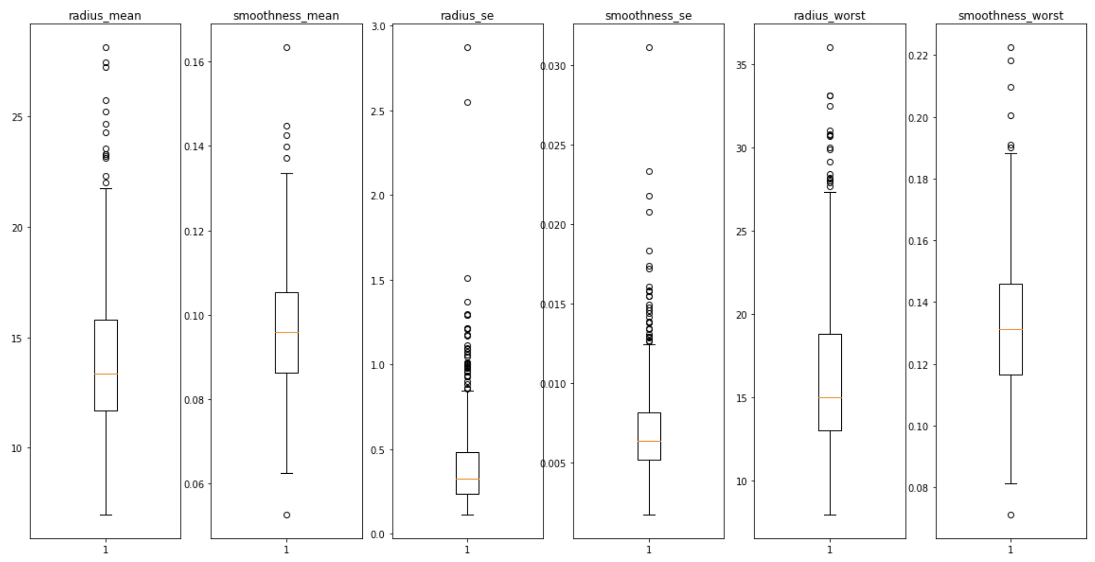
Box Plots
Notes:
Radius and smoothness se is the most irregular datasets because it has the most outlier are clustered while the radius and smoothness worst and mean are more spread out

Slide 11
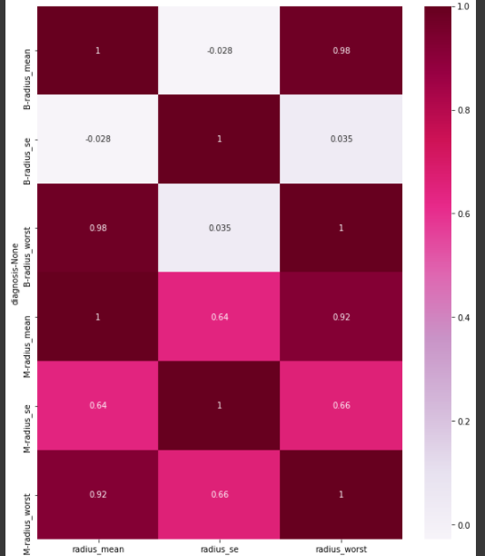
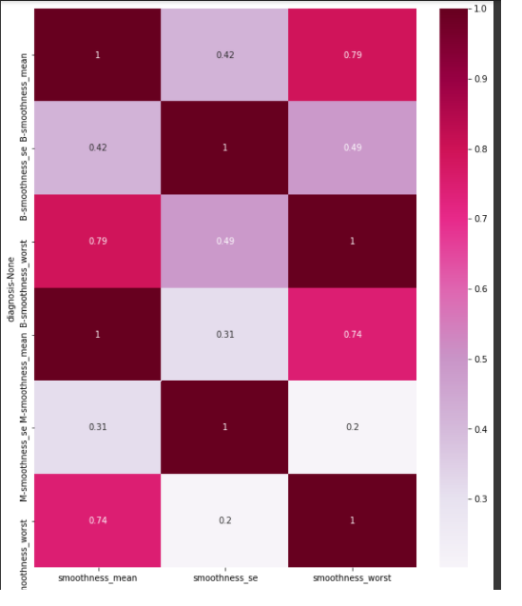
Heatmaps
Notes:
Using the heatmap, we wanted to see if there was a strong correlation between the radius and smoothness
Based off the heatmap there wasn’t really strong correlation between the two variables

Slide 12
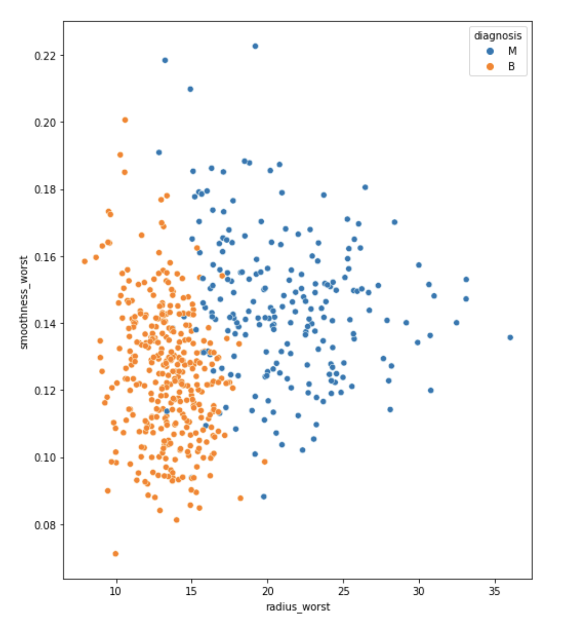
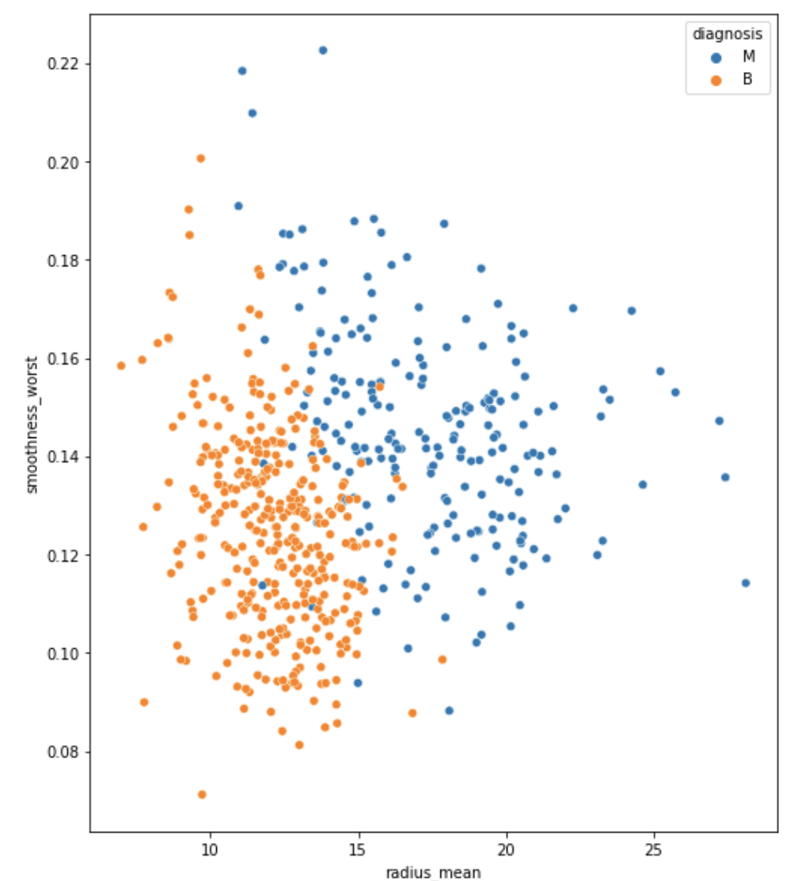
Scatterplot: Smoothness vs Radius
Notes:
With seeing the heatmap not showing much strong correlation we wanted to use a scatter plot show how close the point are with it being clustered. Based off the scatter plot this is a positive correlation if we would a line through it

Slide 13
Experimental Models
The following models were considered for this project:
K Nearest Neighbor
Locates a predefined number of training samples closest in distance to the new point, and predict the label from these. The number of samples can be a user-defined constant (k-nearest neighbor learning), or vary based on the local density of points (radius-based neighbor learning).
Logistic Regression
A statistical model that in its basic form uses a logistic function to model a binary dependent variable, although many more complex extensions exist. In regression analysis, logistic regression (or logit regression) is estimating the parameters of a logistic model (a form of binary regression).

Slide 14
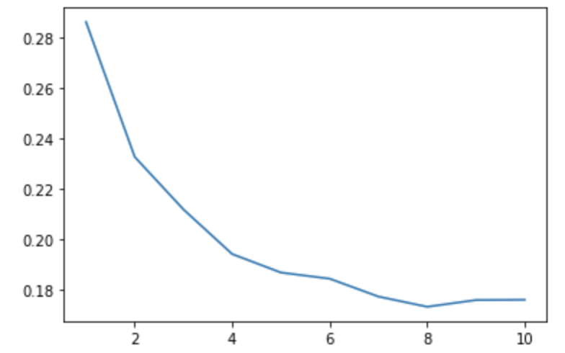
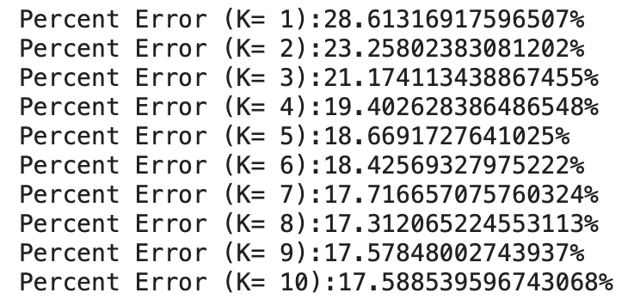
K Nearest Neighbors: Percentage Error

Slide 15
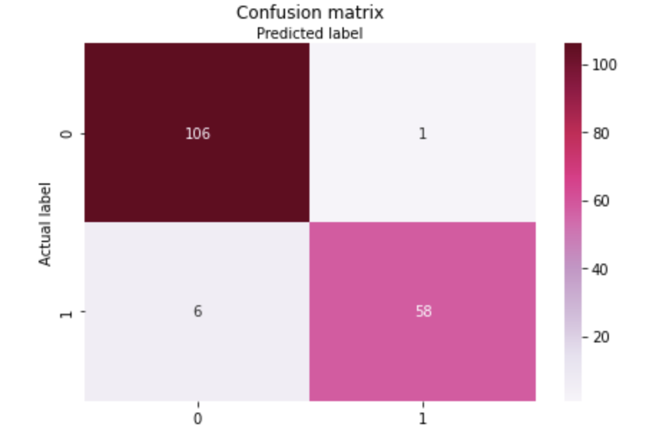
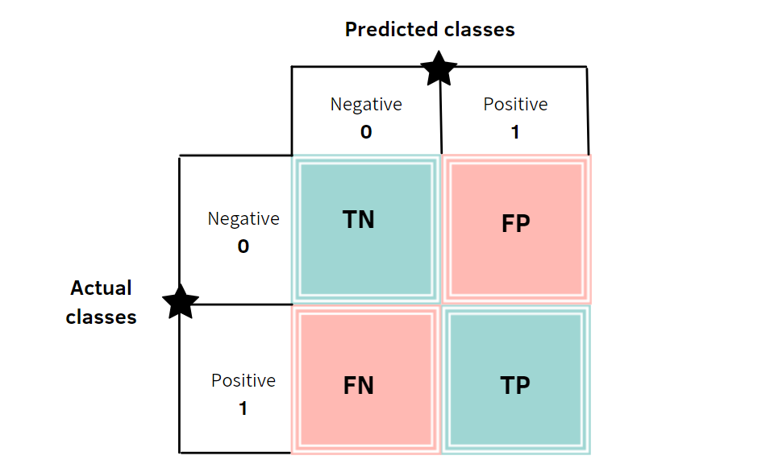
K Nearest Neighbor Model: Confusion Matrix

Slide 16
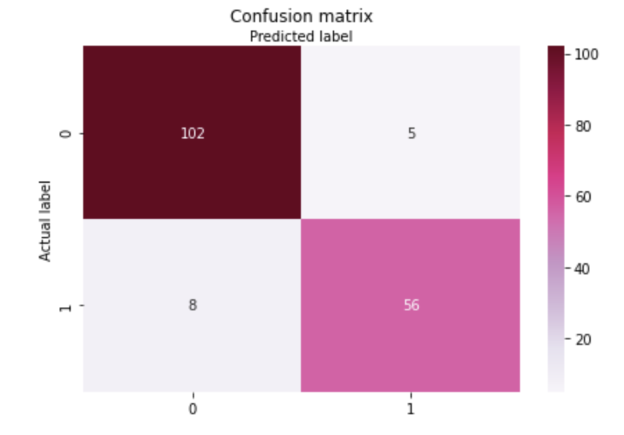
Logistic Regression Model: Confusion Matrix

Slide 17
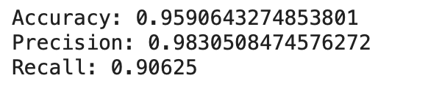
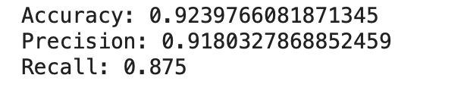
Comparing the Models
Model: K Nearest Neighbor
Model: Logistic Regression

Slide 18

Lessons Learned
Learn from your mistakes
We tried a k nearest neighbor model but initially were unable to produce a percent error under 25%
All data may not be used
Choosing the correct parameters is important

Slide 19
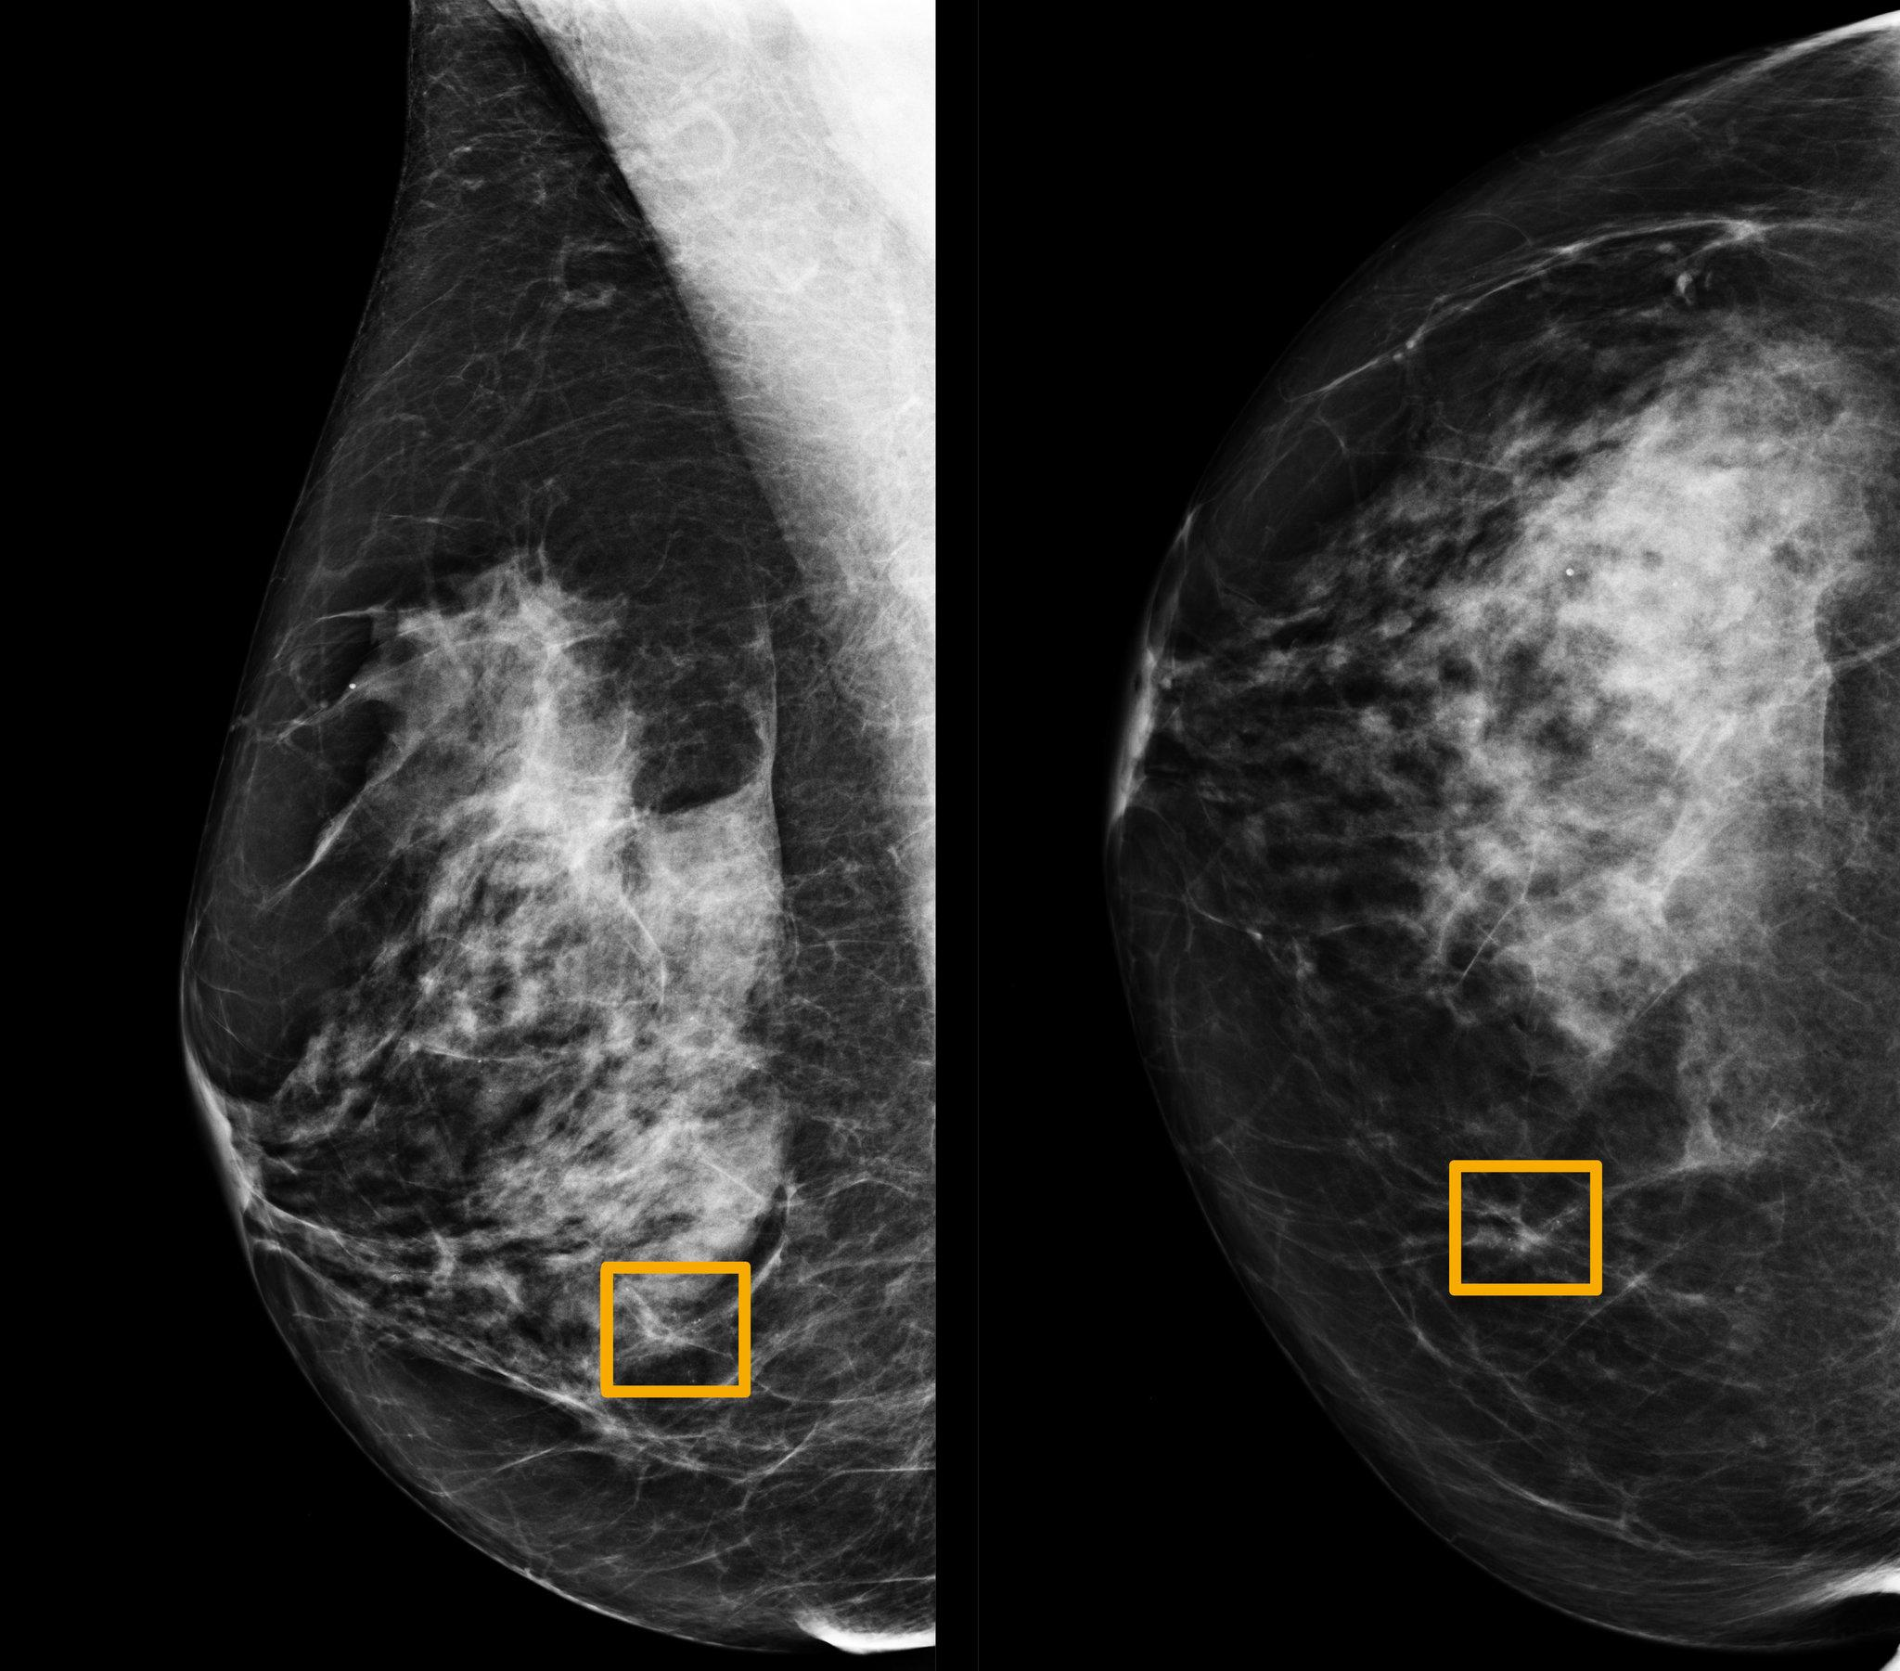
Future Research
Machine learning that uses a patient’s mammogram (images) to predict the formation of tumors
Prediction models that identify high-risk women based on past family history and genetic traits

Slide 20
References
[1] American Cancer Society. (2021, May 7). How Common Is Breast Cancer? | Breast Cancer Statistics. Cancer.Org.
https://www.cancer.org/cancer/breast-cancer/about/how-common-is-breast-cancer.html
[2] Breast Cancer - Statistics. (2021, February 24). Cancer.Net. https://www.cancer.net/cancer-types/breast-cancer/statistics
Ming, C. (2019, June 20). Machine learning techniques for personalized breast cancer risk prediction: comparison with the BCRAT and BOADICEA models. Breast Cancer Research. https://breast-cancer-research.biomedcentral.com/articles/10.1186/s13058-019-1158-4
Li, J. (2021, April 16). Predicting breast cancer 5-year survival using machine learning: A systematic review. PLOS One. https://journals.plos.org/plosone/article?id=10.1371/journal.pone.0250370
“Survival Rates for Breast Cancer.” American Cancer Society,
www.cancer.org/cancer/breast-cancer/understanding-a-breast-cancer-diagnosis/breast-cancer-survival-rates.html.

Slide 21
Questions?

